Slide 1

Replicaset
Nilap Shah
(MongoDB Certified DBA + Developer + Trainer)
https://www.linkedin.com/in/nilap-shah-8b6780a/
Mobile : 9537047334 (WhatsApp)

Slide 2

Replicaset
A replicaset is group of mongod processes that maintains same data across all instances within same set.
It provides high redundancy and high availability
In some cases it provides data locality and availability for distributed systems
You can also maintain copy for disaster recovery, reporting or backup purpose

Slide 3
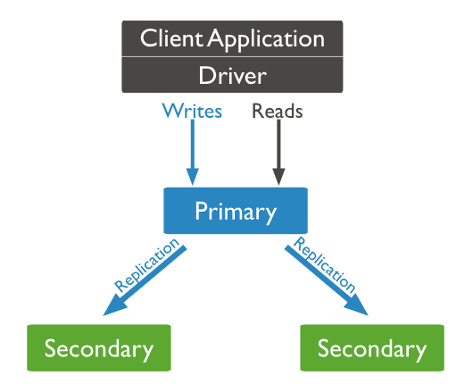
Replicaset Architecture

Slide 4
Replicaset
A replicaset is having several data bearing nodes and one arbiter node
One of its member acts as primary node and other nodes are acts as secondary node
Primary node accepts all write operations first and logged into oplog.rs collection
Secondary nodes are copying operation from primary’s oplog collection and applying that operations
Arbiter is node which do not maintain dataset so it is also called as voting only member

Slide 5
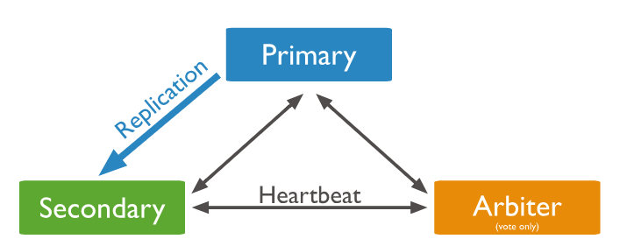
Replicaset Heartbeat

Slide 6
Replicaset Asynchronous Replication
Secondaries applies operations from primary Asynchronously
It might be possible secondaries legging behind primary at the time network slowness or very high write load
Explain Initial Sync
Fault Tolerance & Automatic Retry
It uses multiple threads to improve concurrency using MMAPV1 or WiredTiger Storage engine for replication

Slide 7
Replicaset Deployment Architecture
Replicaset capability and capacity
Standard replicaset starts from minimum 3 number of nodes and it can support upto 50 of nodes
Maximum voting members : 7
Avoid more than one arbiter per replicaset
Add Hidden or Delayed nodes to support backup and reporting
Read heavy application you can configure reads from secondary to improve read performance

Slide 8
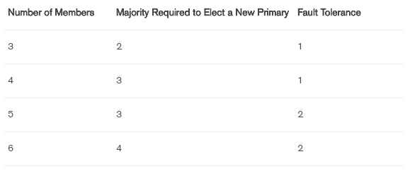
Replicaset fault tolerance

Slide 9
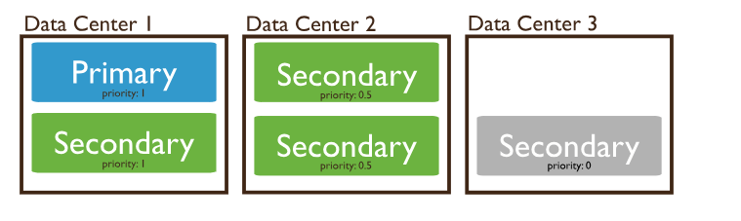
Replicaset Deployment across three data centers

Slide 10
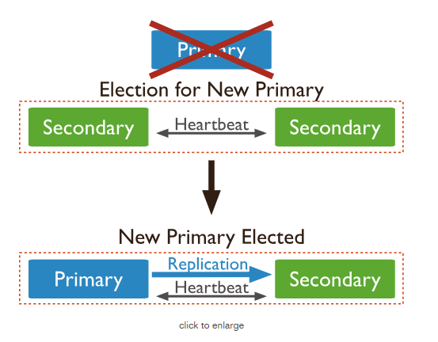
Replicaset Election

Slide 11
Replicaset Voting
Voting Members can have following states
1) Primary
2) Secondary
3) Recovering
4) Arbiter
5) Rollback
Note: Non-voting members must set priority 0

Slide 12
Replicaset Helpers
1) rs.add(host, arbiterOnly)
2) rs.addArb()
3) rs.conf()
4) rs.freeze(seconds)
5) rs.initiate(configuration)
6) rs.printReplicationInfo()
7) rs.printSlaveReplicationInfo()
8) rs.reconfig()
9) rs.remove()
10) rs.slaveOk()
11) rs.stepdown()
12) rs.syncFrom()

Slide 13
Change Priority Replicaset Member
Copy the replicaset configuration to a variable
cfg = rs.conf()
Change Each members priority value
cfg.members[0].priority=0.5;
cfg.members[1].priority=1;
cfg.members[2].priority=1.5;
Assign the replicaset new configuration
rs.reconfig(cfg);
Note: Perform these steps during Maintenance Windows because it seeks for election

Slide 14
Prevent Secondary to become primary (set priority 0)
Copy the replicaset configuration to a variable
cfg = rs.conf()
Change Each members priority value
cfg.members[2].priority=0;
Assign the replicaset new configuration
rs.reconfig(cfg);
Note: Perform these steps during Maintenance Windows because it seeks for election

Slide 15
Configure Hidden Member in Replicaset
Copy the replicaset configuration to a variable
cfg = rs.conf()
Change Each members priority value
cfg.members[2].priority=0;
cfg.members[2].hidden=true;
Assign the replicaset new configuration
rs.reconfig(cfg);
Note: Perform these steps during Maintenance Windows because it seeks for election

Slide 16
Configure Non-Voting Member
Copy the replicaset configuration to a variable
cfg = rs.conf()
Change Each members priority value
cfg.members[4].votes=0;
cfg.members[4]. priority=0;
cfg.members[5].votes=0;
cfg.members[5]. priority=0;
Assign the replicaset new configuration
rs.reconfig(cfg);
Note: Perform these steps during Maintenance Windows because it seeks for election

Slide 17
Configure Replicaset Tags
Copy the replicaset configuration to a variable
cfg = rs.conf()
Change Each members priority value
cfg.members[0].tags={“dc”:”east”,”use”:”production”};
cfg.members[1].tags={“dc”:”east”,”use”:”reporting”};
cfg.members[2].tags={”use”:”production”};
Assign the replicaset new configuration
rs.reconfig(cfg);
Note: Perform these steps during Maintenance Windows because it seeks for election

Slide 18
Thank you
Linked in Profile (Mobile-9537047334)
https://www.linkedin.com/in/nilap-shah-8b6780a/

Slide 19
Nilap Shah
MongoDB (Trainer/DBA/Developer)
Location : Ahmedabad/Banglore
Linked in Profile (Mobile-9537047334)
https://www.linkedin.com/in/nilap-shah-8b6780a/

